Slide 1
Foundations of Data Science Lecture 2
Rumi Chunara, PhD
CS3943/9223
Notes:
Piazza forum reminders, R today

Slide 2
Last Time
What is Data Science?
Data Handling
Doing Data Science
Statistics Review
Polling YOU
About the course
Notes:
About the course: what we’ll cover
what we won’t cover
requirements, workload, grading etc.

Slide 3
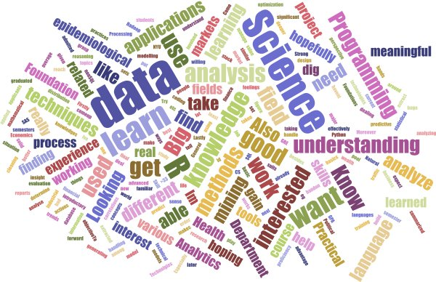
CS3943-9223 Interests
Notes:
Show results from poll
Color data interesting?! We’ll use it for some analyses later.

Slide 4
Today
Intro to R: Basic Commands, Graphics, Indexing Loading Data, Additional Graphical and Numerical Summaries
Types of Data
Data cleaning, sampling, processing
Getting Data + APIs
Assignment 1 out
Notes:
R overview for those who don’t know
Computers please be cordial/move to back

Slide 5
Notes:
Intro to R – material from textbook and?

Slide 6
Types of Data: Flat File Data
n
p
Rows = objects
Columns = measurements on objects
Both n and p can be very large in data mining (also p>>n)
Matrix can be quite sparse

Slide 7
Types of Data: Text Data
Can be represented as a sparse matrix
Text
Documents
Word ID

Slide 8
Types of Data: Transactional Data
Date stamped events (logs, phone calls):
128.195.36.195, -, 3/22/00, 10:35:11, W3SVC, SRVR1, 128.200.39.181, 781, 363, 875, 200, 0, GET, /top.html, -,
128.195.36.195, -, 3/22/00, 10:35:16, W3SVC, SRVR1, 128.200.39.181, 5288, 524, 414, 200, 0, POST, /spt/main.html, -,
128.195.36.195, -, 3/22/00, 10:35:17, W3SVC, SRVR1, 128.200.39.181, 30, 280, 111, 404, 3, GET, /spt/images/bk1.jpg, -,
128.195.36.101, -, 3/22/00, 16:18:50, W3SVC, SRVR1, 128.200.39.181, 60, 425, 72, 304, 0, GET, /top.html, -,
128.195.36.101, -, 3/22/00, 16:18:58, W3SVC, SRVR1, 128.200.39.181, 8322, 527, 414, 200, 0, POST, /spt/main.html, -,
128.195.36.101, -, 3/22/00, 16:18:59, W3SVC, SRVR1, 128.200.39.181, 0, 280, 111, 404, 3, GET, /spt/images/bk1.jpg, -,
128.200.39.17, -, 3/22/00, 20:54:37, W3SVC, SRVR1, 128.200.39.181, 140, 199, 875, 200, 0, GET, /top.html, -,
128.200.39.17, -, 3/22/00, 20:54:55, W3SVC, SRVR1, 128.200.39.181, 17766, 365, 414, 200, 0, POST, /spt/main.html, -,
128.200.39.17, -, 3/22/00, 20:54:55, W3SVC, SRVR1, 128.200.39.181, 0, 258, 111, 404, 3, GET, /spt/images/bk1.jpg, -,
128.200.39.17, -, 3/22/00, 20:55:07, W3SVC, SRVR1, 128.200.39.181, 0, 258, 111, 404, 3, GET, /spt/images/bk1.jpg, -,
128.200.39.17, -, 3/22/00, 20:55:36, W3SVC, SRVR1, 128.200.39.181, 1061, 382, 414, 200, 0, POST, /spt/main.html, -,
128.200.39.17, -, 3/22/00, 20:55:36, W3SVC, SRVR1, 128.200.39.181, 0, 258, 111, 404, 3, GET, /spt/images/bk1.jpg, -,
128.200.39.17, -, 3/22/00, 20:55:39, W3SVC, SRVR1, 128.200.39.181, 0, 258, 111, 404, 3, GET, /spt/images/bk1.jpg, -,
128.200.39.17, -, 3/22/00, 20:56:03, W3SVC, SRVR1, 128.200.39.181, 1081, 382, 414, 200, 0, POST, /spt/main.html, -,
128.200.39.17, -, 3/22/00, 20:56:04, W3SVC, SRVR1, 128.200.39.181, 0, 258, 111, 404, 3, GET, /spt/images/bk1.jpg, -,
128.200.39.17, -, 3/22/00, 20:56:33, W3SVC, SRVR1, 128.200.39.181, 0, 262, 72, 304, 0, GET, /top.html, -,
128.200.39.17, -, 3/22/00, 20:56:52, W3SVC, SRVR1, 128.200.39.181, 19598, 382, 414, 200, 0, POST, /spt/main.html, -,
Can be represented as a time series:
User 1
2
3
2
2
3
3
3
1
1
1
3
1
3
3
3
3
User 2
3
3
3
1
1
1
User 3
7
7
7
7
7
7
7
7
User 4
1
5
1
1
1
5
1
5
1
1
1
1
1
1
User 5
5
1
1
5
…
…

Slide 9
Types of Data: Relational Data
128.200.39.17, -, 3/22/00, 20:55:07, W3SVC, SRVR1, 128.200.39.181, 0, 258, 111, 404, 3, GET, /spt/images/bk1.jpg, -,
128.200.39.17, -, 3/22/00, 20:55:36, W3SVC, SRVR1, 128.200.39.181, 1061, 382, 414, 200, 0, POST, /spt/main.html, -,
128.200.39.17, -, 3/22/00, 20:55:36, W3SVC, SRVR1, 128.200.39.181, 0, 258, 111, 404, 3, GET, /spt/images/bk1.jpg, -,
128.195.36.195, -, 3/22/00, 10:35:11, W3SVC, SRVR1, 128.200.39.181, 781, 363, 875, 200, 0, GET, /top.html, -,
128.195.36.195, -, 3/22/00, 10:35:16, W3SVC, SRVR1, 128.200.39.181, 5288, 524, 414, 200, 0, POST, /spt/main.html, -,
128.195.36.195, -, 3/22/00, 10:35:17, W3SVC, SRVR1, 128.200.39.181, 30, 280, 111, 404, 3, GET, /spt/images/bk1.jpg, -,
…,
128.195.36.195, Doe, John, 12 Main St, 973-462-3421, Madison, NJ, 07932
114.12.12.25,Trank, Jill, 11 Elm St, 998-555-5675, Chester, NJ, 07911
…
Most large data sets are stored in relational data sets
Data query via SQL
07911, Chester, NJ, 07954, 34000, , 40.65, -74.12
07932, Madison, NJ, 56000, 40.642, -74.132
…

Slide 10
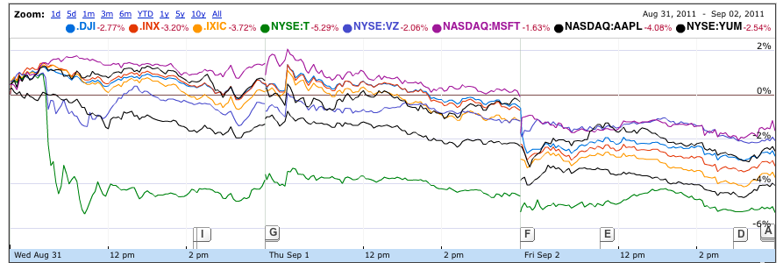
Types of Data: Time Series Data

Slide 11
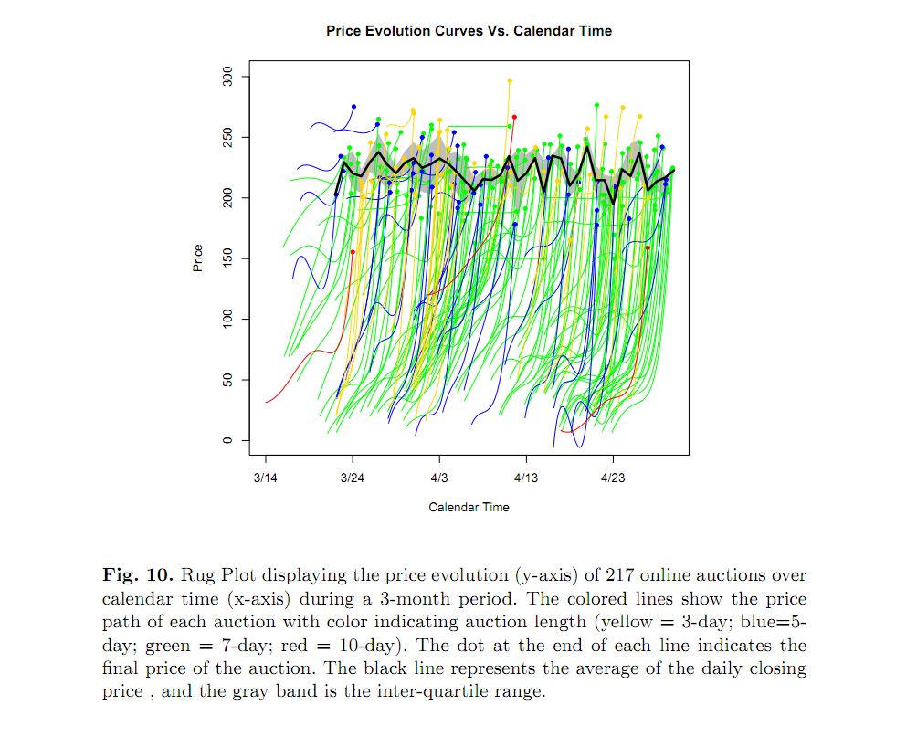
Types of Data: Time Series Data
Jank, Shmueli, et al (2005)

Slide 12
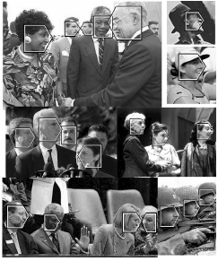
Types of Data: Image Data

Slide 13
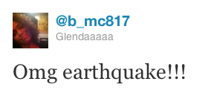
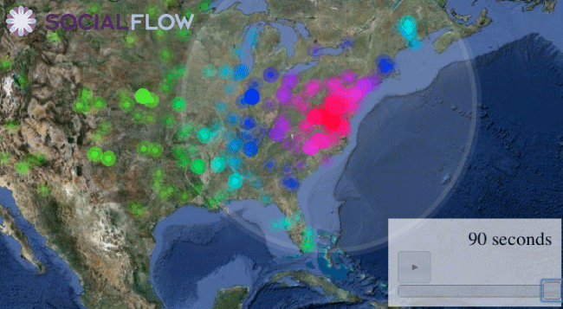
Types of Data: Spatio-Temporal Data
http://senseable.mit.edu/nyte/movies/nyte-globe-encounters.mov-encounters.mov

Slide 14
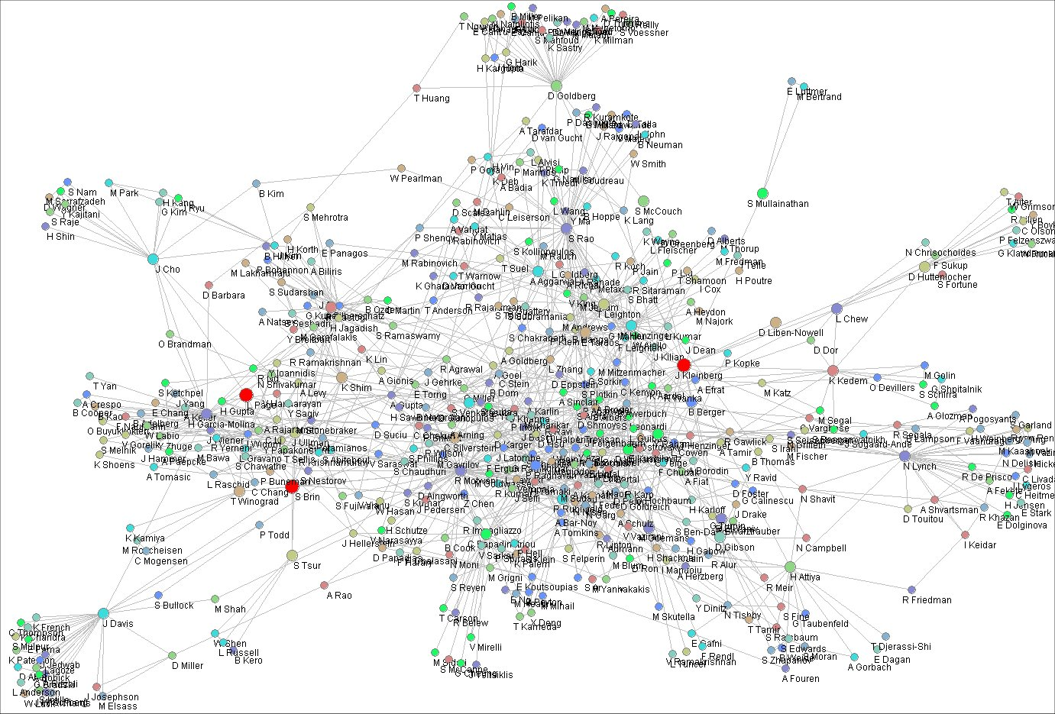
Types of Data: Network Data
Algorithms for estimating relative importance in networks S. White and P. Smyth, ACM SIGKDD, 2003.

Slide 15
Data Preprocessing
15

Slide 16
Data Quality: Why Preprocess the Data?
Measures for data quality: A multidimensional view
Accuracy: correct or wrong, accurate or not
Completeness: not recorded, unavailable, …
Consistency: some modified but some not, dangling, …
Timeliness: timely update?
Believability: how trustable the data are correct?
Interpretability: how easily the data can be understood?

Slide 17
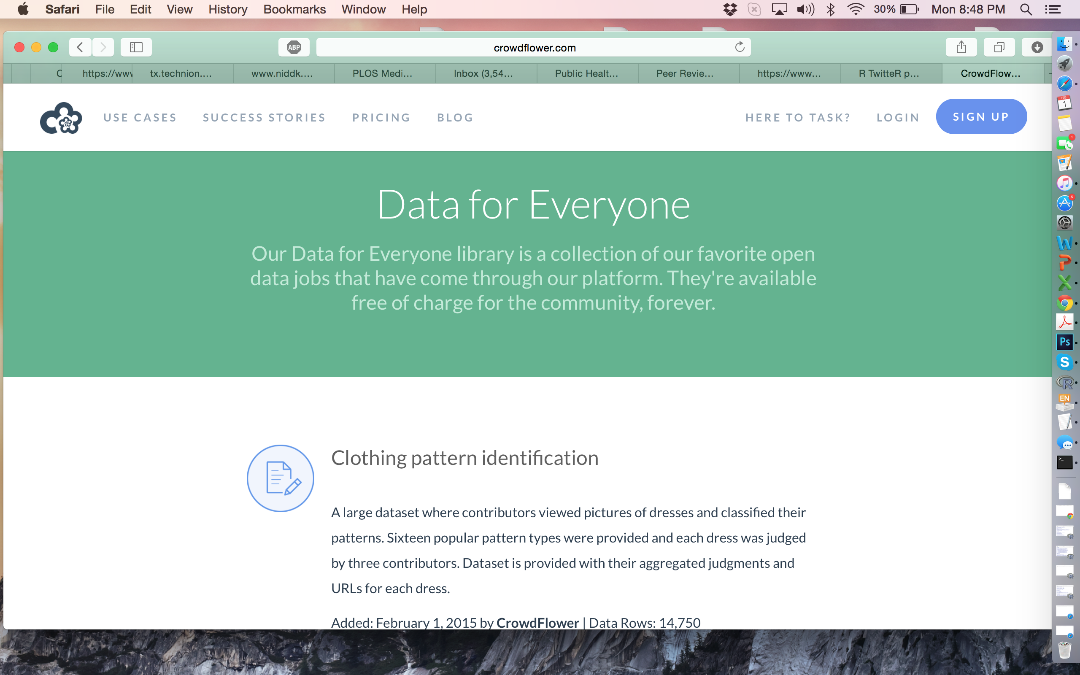

Example: Crowdsourced Accessibility Data
Notes:
Crowdflower: one data source for the project.
Is the map data recent? Are there gaps where it has to be filled in? How well can we establish the metrics from the images? If we want to use the data for inference then how reprsentative of the images in all places? What If the satellite has missed some images (if over time use?)

Slide 18
Major Tasks in Data Preprocessing
Data cleaning
Fill in missing values, smooth noisy data, identify or remove outliers, and resolve inconsistencies
Data integration
Integration of multiple databases, data cubes, or files
Data reduction
Dimensionality reduction
Numerosity reduction
Data compression
Data transformation and data discretization
Normalization
Concept hierarchy generation
Notes:
Reduce data volume by choosing alternative, smaller forms of data representation
Parametric methods (e.g., regression)
Assume the data fits some model, estimate model parameters, store only the parameters, and discard the data (except possible outliers)
Ex.: Log-linear models—obtain value at a point in m-D space as the product on appropriate marginal subspaces
Non-parametric methods
Do not assume models
Major families: histograms, clustering, sampling, …

Slide 19
Major Tasks in Data Preprocessing
Data cleaning
Fill in missing values, smooth noisy data, identify or remove outliers, and resolve inconsistencies
Data integration
Integration of multiple databases, data cubes, or files
Data reduction
Dimensionality reduction
Numerosity reduction
Data compression
Data transformation and data discretization
Normalization
Concept hierarchy generation
Notes:
Reduce data volume by choosing alternative, smaller forms of data representation
Parametric methods (e.g., regression)
Assume the data fits some model, estimate model parameters, store only the parameters, and discard the data (except possible outliers)
Ex.: Log-linear models—obtain value at a point in m-D space as the product on appropriate marginal subspaces
Non-parametric methods
Do not assume models
Major families: histograms, clustering, sampling, …

Slide 20
Data Cleaning
Data in the Real World Is Dirty: Lots of potentially incorrect data, e.g., instrument faulty, human or computer error, transmission error
incomplete: lacking attribute values, lacking certain attributes of interest, or containing only aggregate data
e.g., Occupation=“ ” (missing data)
noisy: containing noise, errors, or outliers
e.g., Salary=“−10” (an error)
inconsistent: containing discrepancies in codes or names, e.g.,
Age=“42”, Birthday=“03/07/2010”
Was rating “1, 2, 3”, now rating “A, B, C”
discrepancy between duplicate records
Intentional (e.g., disguised missing data)
Jan. 1 as everyone’s birthday?

Slide 21
Incomplete (Missing) Data
Data is not always available
E.g., many tuples have no recorded value for several attributes, such as vaccine status in flu data
Missing data may be due to
equipment malfunction
inconsistent with other recorded data and thus deleted
data not entered due to misunderstanding
certain data may not be considered important at the time of entry
not register history or changes of the data
Missing data may need to be inferred
Notes:
A tuple is a collection of values of different types.

Slide 22
How to Handle Missing Data?
Ignore the tuple: usually done when class label is missing (when doing classification)—not effective when the % of missing values per attribute varies considerably
Fill in the missing value manually: tedious + infeasible?
Fill in it automatically with
a global constant : e.g., “unknown”, a new class?!
the attribute mean
the attribute mean for all samples belonging to the same class: smarter
Interpolation (e.g flu trends)
the most probable value: inference-based such as Bayesian formula or decision tree
Notes:
Interpolation example on board

Slide 23
Noisy Data
Noise: random error or variance in a measured variable
Incorrect attribute values may be due to
faulty data collection instruments
data entry problems
data transmission problems
technology limitation
inconsistency in naming convention
Other data problems which require data cleaning
duplicate records
incomplete data
inconsistent data
unstructured data
23
Notes:
23
Depends how you define noise

Slide 24
How to Handle Noisy Data?
Binning
first sort data and partition into (equal-frequency) bins
then one can smooth by bin means, smooth by bin median, smooth by bin boundaries, etc.
Regression
smooth by fitting the data into regression functions
Clustering
detect and remove outliers
Combined computer and human inspection
detect suspicious values and check by human (e.g., deal with possible outliers)

Slide 25
Data Cleaning as a Process
Data discrepancy detection
Use metadata (e.g., domain, range, dependency, distribution)
Check field overloading
Check uniqueness rule, consecutive rule and null rule
Use commercial tools
Data scrubbing: use simple domain knowledge (e.g., postal code, spell-check) to detect errors and make corrections
Data auditing: by analyzing data to discover rules and relationship to detect violators (e.g., correlation and clustering to find outliers)
Data migration and integration
Data migration tools: allow transformations to be specified
ETL (Extraction/Transformation/Loading) tools: allow users to specify transformations through a graphical user interface
Integration of the two processes
Iterative and interactive (e.g., Potter’s Wheels)
Notes:
Potters wheel: An Interactive Data Cleaning System – developed by researchers at berkeley. Allows for interactive data transformation rather than having to use clunky equations.

Slide 26
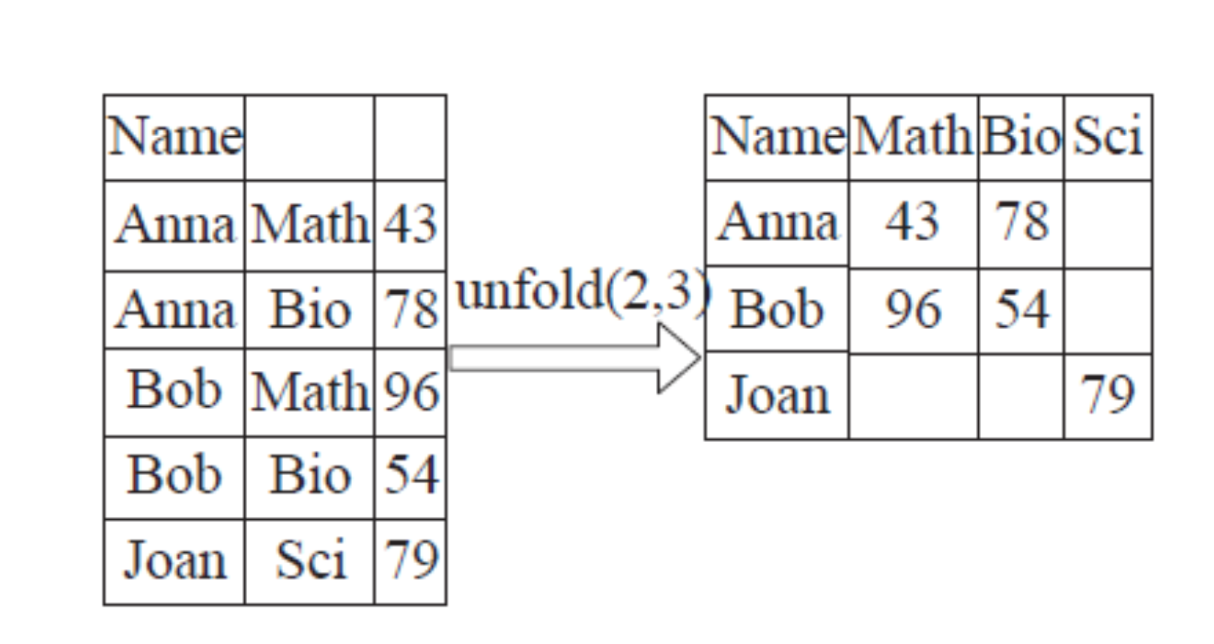
Notes:
Potters wheel example

Slide 27
Major Tasks in Data Preprocessing
Data cleaning
Fill in missing values, smooth noisy data, identify or remove outliers, and resolve inconsistencies
Data integration
Integration of multiple databases, data cubes, or files
Data reduction
Dimensionality reduction
Numerosity reduction
Data compression
Data transformation and data discretization
Normalization
Concept hierarchy generation
Notes:
Reduce data volume by choosing alternative, smaller forms of data representation
Parametric methods (e.g., regression)
Assume the data fits some model, estimate model parameters, store only the parameters, and discard the data (except possible outliers)
Ex.: Log-linear models—obtain value at a point in m-D space as the product on appropriate marginal subspaces
Non-parametric methods
Do not assume models
Major families: histograms, clustering, sampling, …

Slide 28
Data Integration
Combines data from multiple sources into a coherent story
Schema integration: e.g., A.cust-id ≡ B.cust-#
Integrate metadata from different sources
Entity identification problem:
Identify real world entities from multiple data sources, e.g., Bill Clinton = William Clinton
Detecting and resolving data value conflicts
For the same real world entity, attribute values from different sources are different
Possible reasons: different representations, different scales, e.g., metric vs. British units
28

Slide 29
Handling Redundancy in Data Integration
Redundant data occur often when integration of multiple databases
Object identification: The same attribute or object may have different names in different databases
Derivable data: One attribute may be a “derived” attribute in another table, e.g., annual revenue
Redundant attributes may be able to be detected by correlation analysis and covariance analysis
Careful integration of the data from multiple sources may help reduce/avoid redundancies and inconsistencies and improve mining speed and quality
29

Slide 30
Correlation Analysis (Nominal Data)
Χ² (chi-square) test
The larger the Χ² value, the more likely the variables are related
The cells that contribute the most to the Χ² value are those whose actual count is very different from the expected count
Correlation does not imply causality
# of hospitals and # of car-theft in a city are correlated
Both are causally linked to the third variable: population
Notes:
Nominal, ordinal, interval, ratio scales

Slide 31
Chi-Square Calculation: An Example
Χ² (chi-square) calculation (numbers in parenthesis are expected counts calculated based on the data distribution in the two categories)
It shows that like_science_fiction and play_chess are correlated in the group
 | Play chess | Not play chess | Sum (row)
Like science fiction | 250(90) | 200(360) | 450
Not like science fiction | 50(210) | 1000(840) | 1050
Sum(col.) | 300 | 1200 | 1500

Slide 32
Correlation Analysis (Numeric Data)
Correlation coefficient (also called Pearson’s product moment coefficient)
where n is the number of tuples, and are the respective means of A and B, σ_{A} and σ_{B} are the respective standard deviation of A and B, and Σ(a_{i}b_{i}) is the sum of the AB cross-product.
If r_{A,B} > 0, A and B are positively correlated (A’s values increase as B’s). The higher, the stronger correlation.
r_{A,B} = 0: independent; r_{AB} < 0: negatively correlated

Slide 33
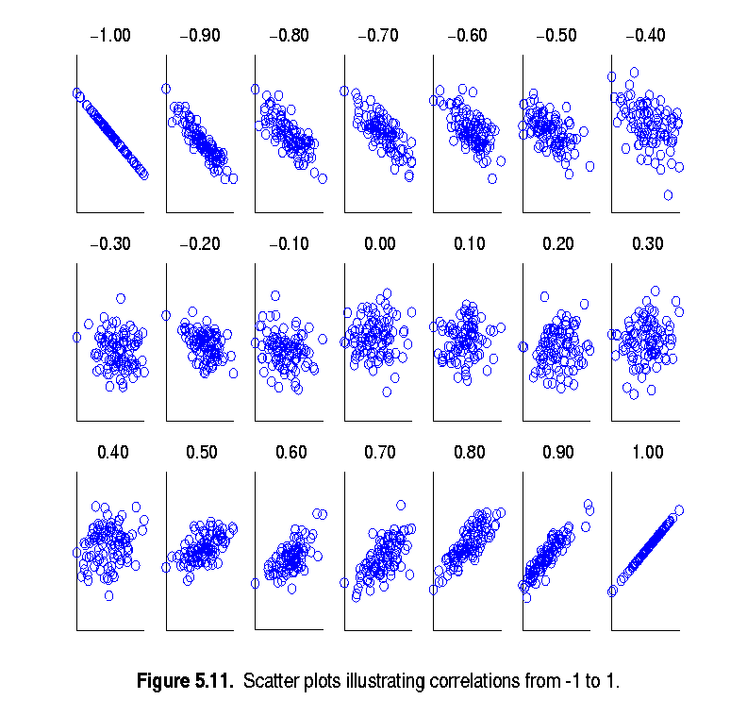
Visually Evaluating Correlation
Scatter plots showing the similarity from –1 to 1.

Slide 34
Correlation (viewed as linear relationship)
Correlation measures the linear relationship between objects
To compute correlation, we standardize data objects, A and B, and then take their dot product

Slide 35
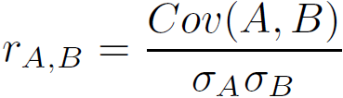
Covariance (Numeric Data)
Covariance is similar to correlation
where n is the number of tuples, and are the respective mean or expected values of A and B, σ_{A} and σ_{B} are the respective standard deviation of A and B.
Positive covariance: If Cov_{A,B} > 0, then A and B both tend to be larger than their expected values.
Negative covariance: If Cov_{A,B} < 0 then if A is larger than its expected value, B is likely to be smaller than its expected value.
Independence: Cov_{A,B} = 0 but the converse is not true:
Some pairs of random variables may have a covariance of 0 but are not independent. Only under some additional assumptions (e.g., the data follow multivariate normal distributions) does a covariance of 0 imply independence
Correlation coefficient:
Notes:
The sign of the covariance therefore shows the tendency in the linear relationship between the variables. The magnitude of the covariance is not easy to interpret. The normalized version of the covariance, the correlation coefficient, however, shows by its magnitude the strength of the linear relation.

Slide 36
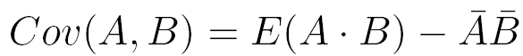
Covariance: An Example
It can be simplified in computation as
Suppose two stocks A and B have the following values in one week: (2, 5), (3, 8), (5, 10), (4, 11), (6, 14).
Question: If the stocks are affected by the same industry trends, will their prices rise or fall together?
E(A) = (2 + 3 + 5 + 4 + 6)/ 5 = 20/5 = 4
E(B) = (5 + 8 + 10 + 11 + 14) /5 = 48/5 = 9.6
Cov(A,B) = (2×5+3×8+5×10+4×11+6×14)/5 − 4 × 9.6 = 4
Thus, A and B rise together since Cov(A, B) > 0.
Notes:
Move example to board

Slide 37
Major Tasks in Data Preprocessing
Data cleaning
Fill in missing values, smooth noisy data, identify or remove outliers, and resolve inconsistencies
Data integration
Integration of multiple databases, data cubes, or files
Data reduction
Dimensionality reduction
Numerosity reduction
Data compression
Data transformation and data discretization
Normalization
Concept hierarchy generation
Notes:
Reduce data volume by choosing alternative, smaller forms of data representation
Parametric methods (e.g., regression)
Assume the data fits some model, estimate model parameters, store only the parameters, and discard the data (except possible outliers)
Ex.: Log-linear models—obtain value at a point in m-D space as the product on appropriate marginal subspaces
Non-parametric methods
Do not assume models
Major families: histograms, clustering, sampling, …

Slide 38
Data Reduction Strategies
Data reduction: Obtain a reduced representation of the data set that is much smaller in volume but yet produces the same (or almost the same) analytical results
Why data reduction? — A database/data warehouse may store terabytes of data. Complex data analysis may take a very long time to run on the complete data set. Also we might want to understand underlying similarities.
Data reduction strategies
Dimensionality reduction, e.g., remove unimportant attributes
Wavelet transforms
Principal Components Analysis (PCA)
Feature subset selection, feature creation
Numerosity reduction (some simply call it: Data Reduction)
Regression and Log-Linear Models
Histograms, clustering, sampling
Data cube aggregation
Data compression

Slide 39
Data Reduction 1: Dimensionality Reduction
Curse of dimensionality
When dimensionality increases, data becomes increasingly sparse
Density and distance between points, which is critical to clustering, outlier analysis, becomes less meaningful
The possible combinations of subspaces will grow exponentially
Dimensionality reduction
Avoid the curse of dimensionality
Help eliminate irrelevant features and reduce noise
Reduce time and space required in data mining
Allow easier visualization
Dimensionality reduction techniques
Wavelet transforms
Principal Component Analysis
Supervised and nonlinear techniques (e.g., feature selection)
Notes:
39

Slide 40
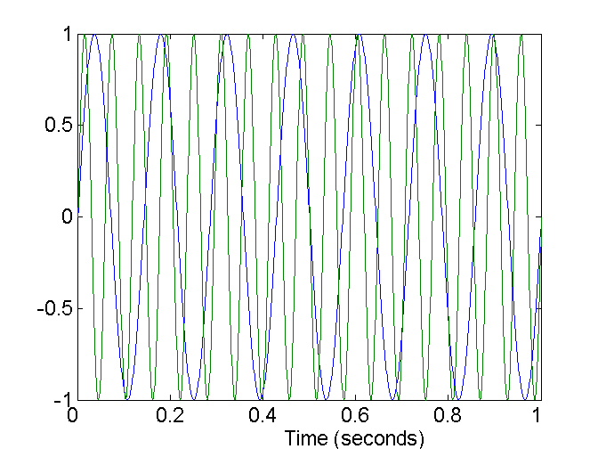
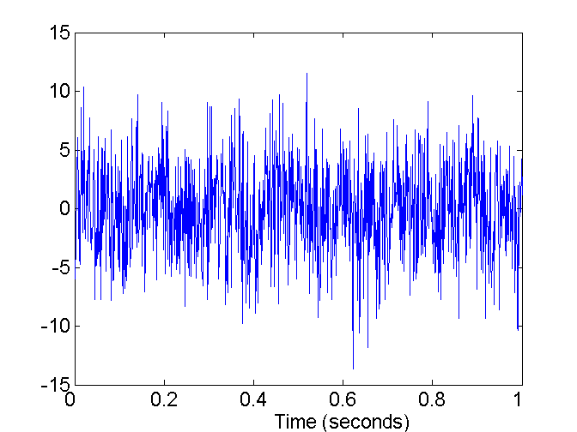
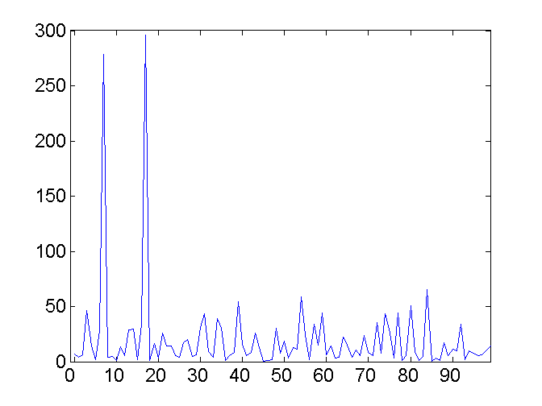
Mapping Data to a New Space
Fourier transform
Wavelet transform
Two Sine Waves
Two Sine Waves + Noise
Frequency
Notes:
40

Slide 41
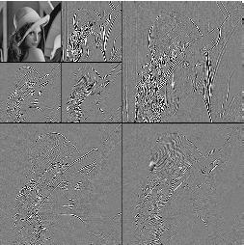
What Is Wavelet Transform?
Decomposes a signal into different frequency subbands
Data are transformed to preserve relative distance between objects at different levels of resolution
Allow natural clusters to become more distinguishable
Used for image compression
Notes:
41

Slide 42
Wavelet Transformation
Haar2
Daubechie4
Discrete wavelet transform (DWT) for linear signal processing, multi-resolution analysis
Compressed approximation: store only a small fraction of the strongest of the wavelet coefficients
Similar to discrete Fourier transform (DFT), but better lossy compression, localized in space
Method:
Length, L, must be an integer power of 2 (padding with 0’s, when necessary)
Each transform has 2 functions: smoothing, difference
Applies to pairs of data, resulting in two sets of data of length L/2
Applies two functions recursively, until reaches the desired length
Notes:
42
Mallat algorithm
Reference: https://books.google.com/books?id=zcFZrhYvVagC&pg=PA8&lpg=PA8&dq=2,+2,+0,+2,+3,+5,+4,+4+wavelet&source=bl&ots=VN08N0BE6I&sig=yF-B3mlBcf9shMiDWQGuPU-S_HM&hl=en&sa=X&ved=0ahUKEwjK99X5pNjKAhXGtBoKHScqBc8Q6AEIKTAD#v=onepage&q=2%2C%202%2C%200%2C%202%2C%203%2C%205%2C%204%2C%204%20wavelet&f=false

Slide 43
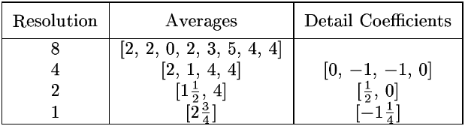
Wavelet Decomposition
Wavelets: A math tool for space-efficient hierarchical decomposition of functions
S = [2, 2, 0, 2, 3, 5, 4, 4] can be transformed to S^ = [2³/₄, -1¹/₄, ¹/₂, 0, 0, -1, -1, 0]
Compression:
Notes:
43
The outputs giving the detail coefficients (from the high-pass filter) and approximation coefficients (from the low-pass)
DC: Differences of the (second of the) averaged values from the computed pairwise average
2-2/2, 0-2/2, 3-5/2, 4-4/2
Final transformation is overall average, then detail coefficients in order of increasing resolution.
Will not go into much more detail of wavelet transformation in this course, but can provide resources and there are R packages if you want to try and implement.

Slide 44
Haar Wavelet Coefficients
Coefficient “Supports”
₊
Hierarchical decomposition structure (a.k.a. “error tree”)
2.75
₋
2.75
₊
+
-1.25
₋
+
-1.25
-
₊
0.5
₋
0.5
0
₊
+
-
+
-
0
₋
0
-1
-1
0
₊
0
₋
+
-
+
-
+
-
+
-
₊
₋
-1
2 2 0 2 3 5 4 4
₊
-1
₋
₊
Original frequency distribution
0
Notes:
44
Useful tool for conceptualizing and visualizing
Each node ci consists of a wavelet coefficient (circled), and each leaf node (at end of tree) a[i] consists of the original data array entries.
This enables us to see the length of the path for reconstruction of any a[i] (log N + 1).
Reconstruct data values d(i)
d(i) = sum (+/-1) * (coefficient on path)
Support for any coefficient ci defined as contiguous range of data-array that ci is used to reconstruct (ie the range of data leaf/nodes in the subtree rooted at ci).

Slide 45
Why Wavelet Transform?
Use hat-shape filters
Emphasize region where points cluster
Suppress weaker information in their boundaries
Effective removal of outliers
Insensitive to noise, insensitive to input order
Multi-resolution
Detect arbitrary shaped clusters at different scales
Efficient
Complexity O(N)
Only applicable to low dimensional data
Notes:
45

Slide 46
Principal Component Analysis (PCA)
Find a projection that captures the largest amount of variation in data
The original data are projected onto a much smaller space, resulting in dimensionality reduction. We find the eigenvectors of the covariance matrix, and these eigenvectors define the new space
x₂
e
x₁

Slide 47
Principal Component Analysis (Steps)
Given N data vectors from n-dimensions, find k ≤ n orthogonal vectors (principal components) that can be best used to represent data
Normalize input data: Each attribute falls within the same range
Compute k orthonormal (unit) vectors, i.e., principal components
Each input data (vector) is a linear combination of the k principal component vectors
The principal components are sorted in order of decreasing “significance” or strength
Since the components are sorted, the size of the data can be reduced by eliminating the weak components, i.e., those with low variance (i.e., using the strongest principal components, it is possible to reconstruct a good approximation of the original data)
Works for numeric data only

Slide 48
Attribute Subset Selection
Another way to reduce dimensionality of data
Redundant attributes
Duplicate much or all of the information contained in one or more other attributes
E.g., purchase price of a product and the amount of sales tax paid
Irrelevant attributes
Contain no information that is useful for the data mining task at hand
E.g., students' ID is often irrelevant to the task of predicting students' GPA

Slide 49
Heuristic Search in Attribute Selection
There are 2^{d} possible attribute combinations of d attributes
Typical heuristic attribute selection methods:
Best single attribute under the attribute independence assumption: choose by significance tests
Best step-wise feature selection:
The best single-attribute is picked first
Then next best attribute condition to the first, ...
Step-wise attribute elimination:
Repeatedly eliminate the worst attribute
Best combined attribute selection and elimination
Optimal branch and bound:
Use attribute elimination and backtracking
Notes:
Query search example
A branch-and-bound algorithm consists of a systematic enumeration of candidate solutions by means of state space search:
the set of candidate solutions is thought of as forming a rooted tree with the full set at the root. The algorithm explores branches of this tree, which represent subsets of the solution set. Before enumerating the candidate solutions of a branch, the branch is checked against upper and lower estimated bounds on the optimal solution, and is discarded if it cannot produce a better solution than the best one found so far by the algorithm.

Slide 50
Attribute Creation (Feature Generation)
50
Create new attributes (features) that can capture the important information in a data set more effectively than the original ones
Three general methodologies
Attribute extraction
Domain-specific
Mapping data to new space (see: data reduction)
E.g., Fourier transformation, wavelet transformation, manifold approaches (not covered)
Attribute construction
Combining features (see: discriminative frequent patterns in Chapter 7)
Data discretization
Notes:
50
Feature extraction a type of dimensionality reduction that efficiently represents interesting parts of an image as a compact feature vector. This approach is useful when image sizes are large and a reduced feature representation is required to quickly complete tasks such as image matching and retrieval. E.g. symptoms -> ILI
Construction could be pre-processing, or in the data prep stage.

Slide 51
Clustering
Partition data set into clusters based on similarity, and store cluster representation (e.g., centroid and diameter) only
Can be very effective if data is clustered but not if data is “smeared”
Can have hierarchical clustering and be stored in multi-dimensional index tree structures
There are many choices of clustering definitions and clustering algorithms
Cluster analysis methods in future lectures

Slide 52
Sampling
Sampling: obtaining a small sample s to represent the whole data set N
Allow a mining algorithm to run in complexity that is potentially sub-linear to the size of the data
Key principle: Choose a representative subset of the data
Simple random sampling may have very poor performance in the presence of skew
Develop adaptive sampling methods, e.g., stratified sampling:
Note: Sampling may not reduce database I/Os (page at a time)

Slide 53
Types of Sampling
Simple random sampling
There is an equal probability of selecting any particular item
Sampling without replacement
Once an object is selected, it is removed from the population
Sampling with replacement
A selected object is not removed from the population
Stratified sampling:
Partition the data set, and draw samples from each partition (proportionally, i.e., approximately the same percentage of the data)
Used in conjunction with skewed data
Notes:
Examples: occupancy modeling (with replacement)

Slide 54
Sampling: With or without Replacement
SRSWOR
(simple random
sample without
replacement)
SRSWR
Raw Data

Slide 55
Sampling: Cluster or Stratified Sampling
Raw Data
Cluster/Stratified Sample
Notes:
Surveying.

Slide 56
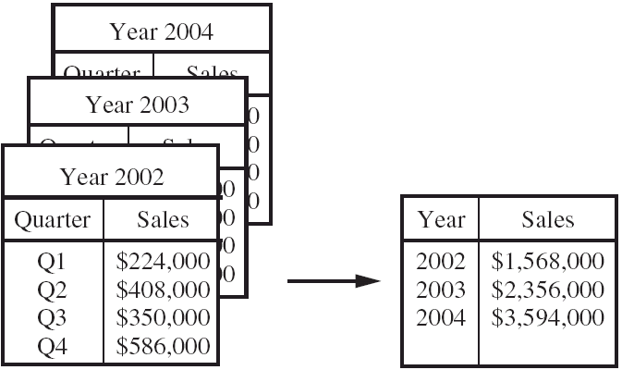
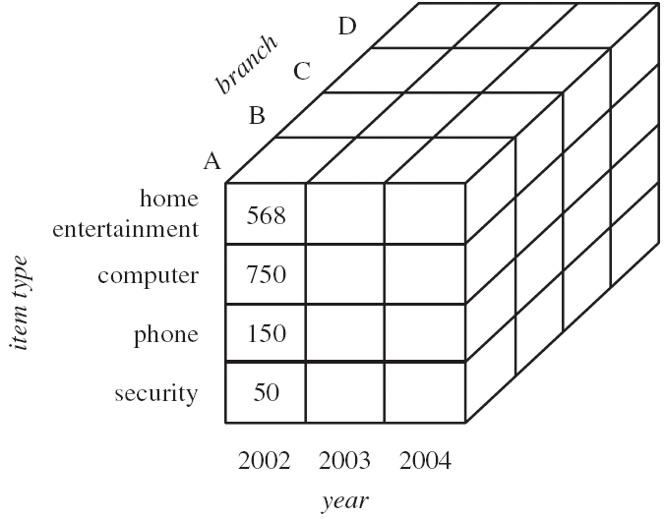
Data Cube Aggregation
Notes:
The SQL aggregate functions and the GROUP BY operator produce zero-dimensional or one-dimensional aggregates. Applications need the N-dimensional generalization of these operators. This paper defines that operator, called the data cube or simply cube. The cube operator generalizes the histogram, cross-tabulation, roll-up, drill-down, and sub-total constructs found in most report writers. The novelty is that cubes are relations. Consequently, the cube operator can be imbedded in more complex non-procedural data analysis programs. The cube operator treats each of the N aggregation attributes as a dimension of N-space. The aggregate of a particular set of attribute values is a point in this space. The set of points forms an N-dimensional cube

Slide 57
Data Cube Aggregation
The lowest level of a data cube (base cuboid)
The aggregated data for an individual entity of interest
Multiple levels of aggregation in data cubes
Further reduce the size of data to deal with
Reference appropriate levels
Use the smallest representation which is enough to solve the task
Queries regarding aggregated information should be answered using data cube, when possible
Notes:
57
Aggregates and group-by operators produce 0- or 1-dimensional answers; cross-tabs produce 2-d answers; the data-cube produces N-dimensional aggregates and answers by treating each of the N aggregation attributes as a dimension of N-space.

Slide 58
Data Reduction 3: Data Compression
String compression
There are extensive theories and well-tuned algorithms
Typically lossless, but only limited manipulation is possible without expansion
Audio/video compression
Typically lossy compression, with progressive refinement
Sometimes small fragments of signal can be reconstructed without reconstructing the whole
Time sequence is not audio
Typically short and vary slowly with time
Dimensionality and numerosity reduction may also be considered as forms of data compression
Notes:
58

Slide 59
Data Compression
Original Data
Compressed
Data
lossless
Original Data
Approximated
lossy
Notes:
59

Slide 60
Major Tasks in Data Preprocessing
Data cleaning
Fill in missing values, smooth noisy data, identify or remove outliers, and resolve inconsistencies
Data integration
Integration of multiple databases, data cubes, or files
Data reduction
Dimensionality reduction
Numerosity reduction
Data compression
Data transformation and data discretization
Normalization
Concept hierarchy generation
Notes:
Reduce data volume by choosing alternative, smaller forms of data representation
Parametric methods (e.g., regression)
Assume the data fits some model, estimate model parameters, store only the parameters, and discard the data (except possible outliers)
Ex.: Log-linear models—obtain value at a point in m-D space as the product on appropriate marginal subspaces
Non-parametric methods
Do not assume models
Major families: histograms, clustering, sampling, …

Slide 61
Data Transformation
A function that maps the entire set of values of a given attribute to a new set of replacement values s.t. each old value can be identified with one of the new values
Methods
Smoothing: Remove noise from data
Attribute/feature construction
New attributes constructed from the given ones
Aggregation: Summarization, data cube construction
Normalization: Scaled to fall within a smaller, specified range
min-max normalization
z-score normalization
normalization by decimal scaling
Discretization: Concept hierarchy climbing
Notes:
61

Slide 62
Normalization
Min-max normalization: to [new_min_{A}, new_max_{A}]
Ex. Let income range $12,000 to $98,000 normalized to [0.0, 1.0]. Then $73,000 is mapped to
Z-score normalization (μ: mean, σ: standard deviation):
Ex. Let μ = 54,000, σ = 16,000. Then
Normalization by decimal scaling
Where j is the smallest integer such that Max(|ν’|) < 1

Slide 63
Discretization
Three types of attributes
Nominal—values from an unordered set, e.g., color, profession
Ordinal—values from an ordered set, e.g., military or academic rank
Numeric—real numbers, e.g., integer or real numbers
Discretization: Divide the range of a continuous attribute into intervals
Interval labels can then be used to replace actual data values
Reduce data size by discretization
Supervised vs. unsupervised
Split (top-down) vs. merge (bottom-up)
Discretization can be performed recursively on an attribute
Prepare for further analysis, e.g., classification

Slide 64
Data Discretization Methods
Typical methods: All the methods can be applied recursively
Binning
Top-down split, unsupervised
Histogram analysis
Top-down split, unsupervised
Clustering analysis (unsupervised, top-down split or bottom-up merge)
Decision-tree analysis (supervised, top-down split)
Correlation (e.g., χ²) analysis (unsupervised, bottom-up merge)
64
Notes:
64

Slide 65
Simple Discretization: Binning
Equal-width (distance) partitioning
Divides the range into N intervals of equal size: uniform grid
if A and B are the lowest and highest values of the attribute, the width of intervals will be: W = (B –A)/N.
The most straightforward, but outliers may dominate presentation
Skewed data is not handled well
Equal-depth (frequency) partitioning
Divides the range into N intervals, each containing approximately same number of samples
Good data scaling
Managing categorical attributes can be tricky

Slide 66
Histogram Analysis
Divide data into buckets and store average (sum) for each bucket
Partitioning rules:
Equal-width: equal bucket range
Equal-frequency (or equal-depth)

Slide 67
Binning Methods for Data Smoothing
Sorted data for price (in dollars): 4, 8, 9, 15, 21, 21, 24, 25, 26, 28, 29, 34
* Partition into equal-frequency (equi-depth) bins:
- Bin 1: 4, 8, 9, 15
- Bin 2: 21, 21, 24, 25
- Bin 3: 26, 28, 29, 34
* Smoothing by bin means:
- Bin 1: 9, 9, 9, 9
- Bin 2: 23, 23, 23, 23
- Bin 3: 29, 29, 29, 29
* Smoothing by bin boundaries:
- Bin 1: 4, 4, 4, 15
- Bin 2: 21, 21, 25, 25
- Bin 3: 26, 26, 26, 34

Slide 68
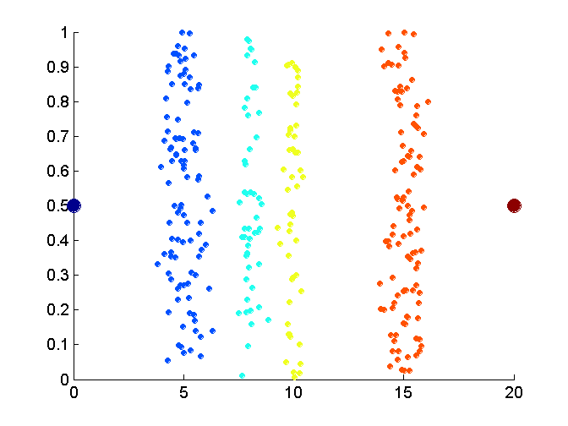
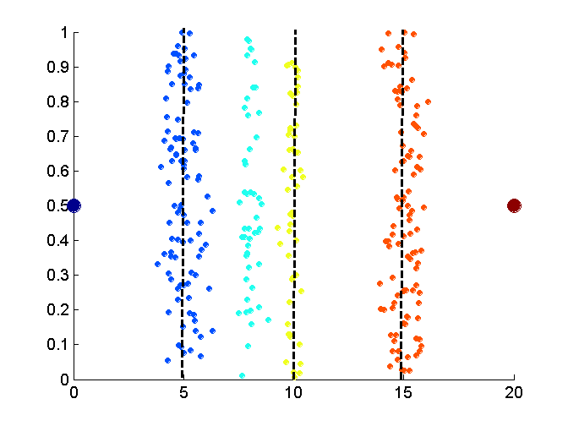
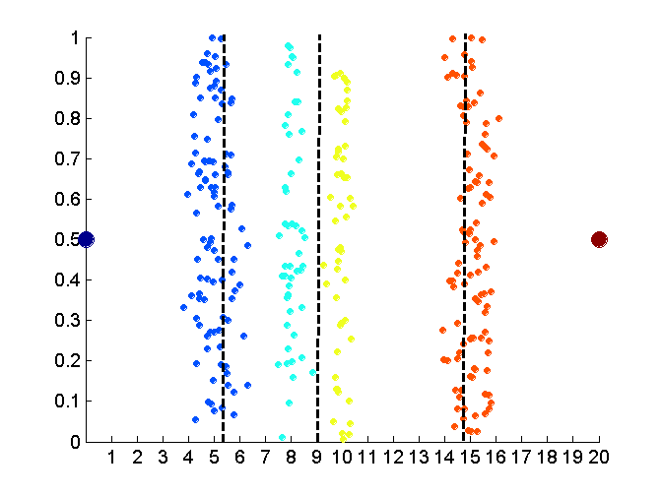
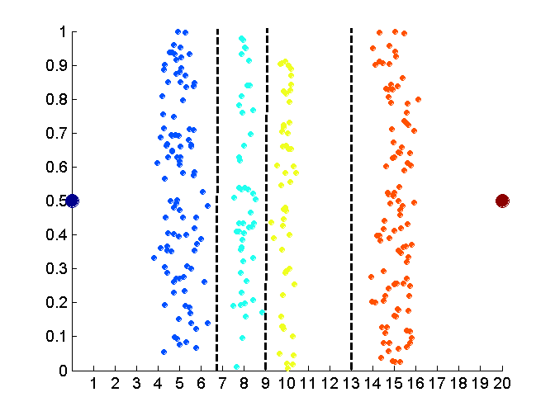
Discretization Without Using Class Labels (Binning vs. Clustering)
Data
Equal interval width (binning)
Equal frequency (binning)
K-means clustering leads to better results
68
Notes:
68

Slide 69
Discretization by Classification & Correlation Analysis
Classification (e.g., decision tree analysis)
Supervised: Given class labels, e.g., cancerous vs. benign
Using entropy to determine split point (discretization point)
Top-down, recursive split
Correlation analysis (e.g., Chi-merge: χ²-based discretization)
Supervised: use class information
Bottom-up merge: find the best neighboring intervals (those having similar distributions of classes, i.e., low χ² values) to merge
Merge performed recursively, until a predefined stopping condition
69
Notes:
69
Chi merge is a simple algorithm that uses the chi-square statistic to discretize numeric attributes. It is a supervised, bottom-up data discretization method. It checks each pair of adjacent rows in order to determine if the class frequencies of the two intervals are significantly different. It tests the following hypothesis: that the two adjacent intervals are independent. If the hypothesis is confirmed the intervals are merged into a single interval, if not, they remain separated.

Slide 70
Concept Hierarchy Generation
Concept hierarchy organizes concepts (i.e., attribute values) hierarchically and is usually associated with each dimension in a data warehouse
Concept hierarchies facilitate drilling and rolling in data warehouses to view data in multiple granularity
Concept hierarchy formation: Recursively reduce the data by collecting and replacing low level concepts (such as numeric values for age) by higher level concepts (such as youth, adult, or senior)
Concept hierarchies can be explicitly specified by domain experts and/or data warehouse designers
Concept hierarchy can be automatically formed for both numeric and nominal data. For numeric data, use discretization methods shown.
Notes:
Hierarchy can be explicit in the database schema
5 methods: binning histogram analysis entropy-based discretization and data segmentation by “natural partitioning”

Slide 71
Concept Hierarchy Generation for Nominal Data
Specification of a partial/total ordering of attributes explicitly at the schema level by users or experts
street < city < state < country
Specification of a hierarchy for a set of values by explicit data grouping
{Urbana, Champaign, Chicago} < Illinois
Specification of only a partial set of attributes
E.g., only street < city, not others
Automatic generation of hierarchies (or attribute levels) by the analysis of the number of distinct values
E.g., for a set of attributes: {street, city, state, country}

Slide 72
Automatic Concept Hierarchy Generation
Some hierarchies can be automatically generated based on the analysis of the number of distinct values per attribute in the data set
The attribute with the most distinct values is placed at the lowest level of the hierarchy
Exceptions, e.g., weekday, month, quarter, year
country
15 distinct values
province_or_ state
365 distinct values
city
3567 distinct values
street
674,339 distinct values

Slide 74
Pulling Data from Twitter: R
Apps.twitter.com (create new application)
Set callback URL to http://127.0.0.1:1410
You will get: consumer_key , consumer_secret, access_token, access_secret
Notes:
You will get

Slide 75
Here is the code I used for setting up the pull:
library(httr)
library(devtools)
library(twitteR)
library(base64enc)
consumer_key <- 'XXXXXXXXXXXX'
consumer_secret <- 'XXXXXXXXXXXX'
access_token <- 'XXXXXXXXXXXX'
access_secret <- 'XXXXXXXXXXXX'
setup_twitter_oauth(consumer_key , consumer_secret, access_token, access_secret)
Notes:
Let’s get some data!

Slide 76
Example Calls
tw <- searchTwitter(”rumi",n=100,lang="en")
(further arguments including time/location filtering)
tw.df <- do.call("rbind", lapply(test, as.data.frame))
Many man pages to look at, for example take a look at page for Token in httr for an explanation of how the library/functions handle caching

Slide 77
Try This Out in R
Retrieve data for a set time period and with a selected feature (i.e. keyword or set of keywords)
Organize the data into a structured table (account/clean for missing data via a convention or other methods)
Plot a time-series of the data and identify any trends (descriptive statistics and qualitative description)
If you’re ahead: try to articulate a concept hierarchy (how? Maybe need to reduce dimensions first, use PCA?), are there other data that are correlated?
Notes:
Dimension reduction. For example, are there overall themes in discussion? How about over time? Related to location?
Concept hierarchy, other data correlated?

Slide 78
Summary
Data quality: accuracy, completeness, consistency, timeliness, believability, interpretability
Data cleaning: e.g. missing/noisy values, outliers
Data integration from multiple sources:
Entity identification problem
Remove redundancies
Detect inconsistencies
Data reduction
Dimensionality reduction
Numerosity reduction
Data compression
Data transformation and data discretization
Normalization
Concept hierarchy generation

Slide 79
Next Time
Regression
Clustering
Assignment 1 due on 2/16 9am (no late policy)

